Slide 1

Microsoft Azure Immersion Workshop: Infrastructure Migration
Session 3: Defining your Migration Approach

Slide 2
Group Challenge: Review the customer case study
ToDo
Analyze your customer needs.
Identify the drivers for cloud.
Understand the customer environment
Timeframe
10 minutes – Review customer Case Study
10 minutes – Design a proof of concept solution
10 minutes – Present the solution

Slide 3
Sources:
Customer Needs (only Step 1)
Customer PoC App Environment for Migration
ttps://github.com/microsoft/MCW-Line-of-business-application-migration/blob/master/Whiteboard%20design%20session/WDS%20student%20guide%20-%20Line-of-business%20application%20migration.md#step-1-review-the-customer-case-study

Slide 4
10 minutes – Step I: Review customer Case Study

Slide 5
Customer background
Smart Hotel Corp is a major hospitality e-commerce company owning series of hotel chains across the world.
Smart Hotel Corp wants to consolidate their websites, IT environment and streamline their operation by moving to the cloud.
Founded in 1972 and based in Columbus, Ohio
Turnover in 2018 exceeded 350 million USD
Notes:
Smart Hotel Corp is a major hospitality e-commerce company owning series of hotel chains across the world.
Smart Hotel Corp wants to consolidate their sprawl IT environment and streamline their operation by moving to the cloud.
Founded in 1972 and based in Columbus, Ohio, their business comprises three major product families (hotel, online booking, exotic travel experience booking). Customers comprise familiar brand-name hotels, and also includes large-scale hotel chains. Turnover in 2018 exceeded 350 million USD.

Slide 6
Customer situation
Sprawling IT estate, including a substantial legacy server footprint
Windows servers including both x32 and x64 hardware running Windows Server 2003 through to 2016
Linux servers running a mix of Red Hat Enterprise Linux 5.8 and 7 series (7.2 through 7.6), Suse Linux Enterprise Server 12, and Ubuntu 16.04
The above servers comprise both physical machines as well as VMs hosted on VMware infrastructure managed by vCenter 6.5
Multiple database engines, including Microsoft SQL Server, PostGreSQL, and Cassandra
448 servers identified
No clear view of entire estate
Notes:
The CTO, James Lynch, was hired 6 months ago from outside the company, with a mandate to address ever-increasing IT costs. He has identified a sprawling IT estate, including a substantial legacy server footprint. New servers and services have been accumulated over time, without consolidating existing infrastructure. This includes:
- Windows servers including both x32 and x64 hardware running Windows Server 2003 through to 2016
- Linux servers running a mix of RHEL 6.10 and 7 series (7.2 through 7.6), SLES 12, and Ubuntu 16.04
- The above servers comprise both physical machines as well as VMs hosted on VMware infrastructure managed by vCenter 6.5
- Multiple database engines, including Microsoft SQL Server, PostgreSQL, and Cassandra
In total, 448 servers and VMs have been identified to date, distributed across 5 main locations, all in the US. There is a complex web of dependencies between servers and no-one has a clear view of the entire estate. Fear of breaking an existing system has been one of the drivers of server count and sprawl.

Slide 7
Customer situation
The CTO, James Lynch, was hired 6 months ago from outside the company
Mandate to address ever-increasing IT costs
Board has approved strategy to migrate as much existing IT infrastructure as possible to Azure
Goals:
Eliminate IT infrastructure overheads
Clean house
Create a modern, fit-for-purpose IT environment
Save costs
Notes:
To address this, James has proposed to the board that Fabrikam should migrate as much of the existing IT infrastructure as possible to the cloud. As well as eliminating IT infrastructure overheads, this will be an opportunity to 'clean house' and create a modern, fit-for-purpose IT environment, as well as realizing substantial cost savings relative to their current infrastructure. The board have agreed, and Microsoft Azure has been selected as the cloud provider.

Slide 8
Customer needs
Identify which servers (physical and virtual) can be migrated to Azure, and what modifications (if any) are required.
Create a road map of prioritized migrations, accounting for ease of migration and dependencies.
Where suitable, migrate existing servers and databases to Azure as efficiently as possible.

Slide 9
Customer needs
Where existing servers cannot be migrated, identify alternative migration strategies (refactor, re-architect, etc.) and their pros/cons.
Prior to migration, accurately forecast the costs associated with each migrated workload, including any third-party licensing costs.
Post-migration, be able to track costs, control usage, cross-charge business owners, and identify cost-saving opportunities.

Slide 10
Customer objections
Owners of each business application will require evidence that migration will be successful before granting approval.
Smart Hotel have negotiated an Enterprise Agreement (EA) with Microsoft for their Azure consumption. Any cost estimates need to reflect their EA discount.
Many applications comprise multiple components or tiers. How can you ensure that these migrations are appropriately orchestrated?

Slide 11
Customer objections
To reduce business impact, each migration should be designed to minimize application downtime. In addition, to risk, there must be an option to fail-back should the migration experience an unexpected problem.
We are expecting to move all our existing infrastructure to Azure. Reducing our on-premises server costs should provide substantial cost savings. Can you confirm what savings we can expect?

Slide 12
Customer Environment
Huy An

Slide 13
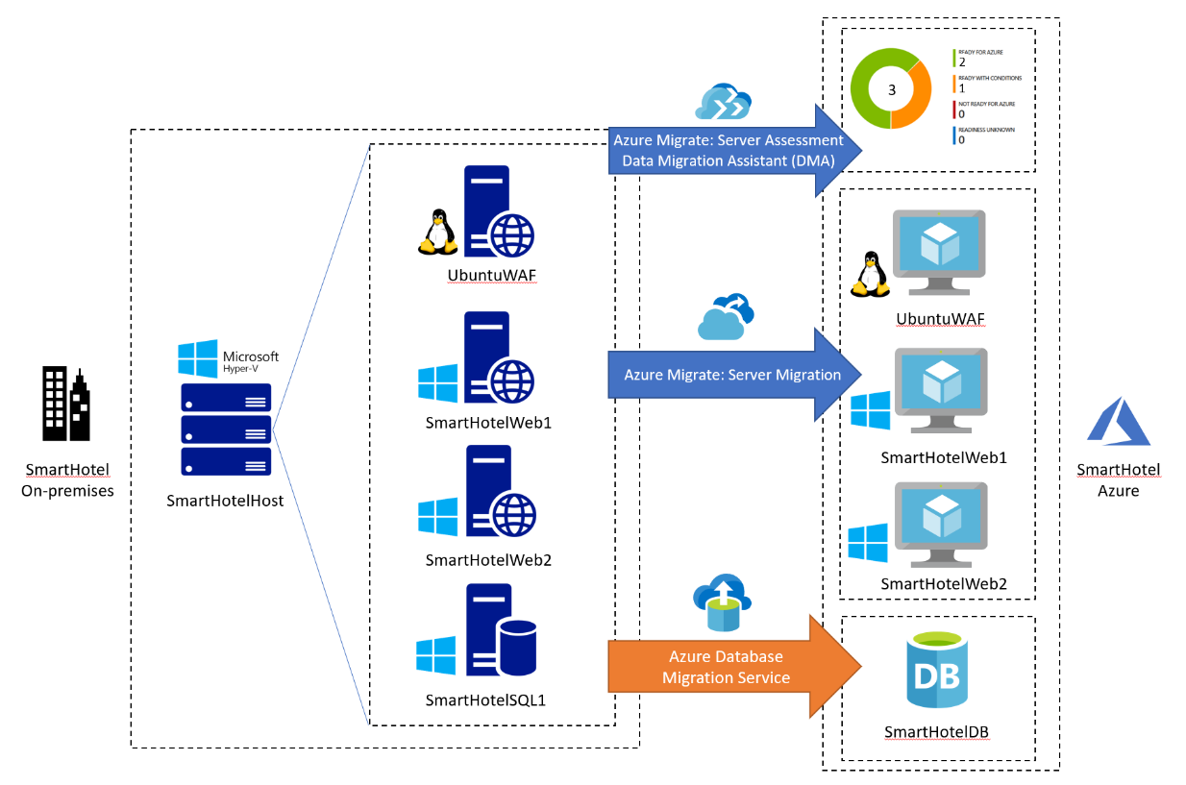
Smart Hotel Online Booking Application
We'll be focusing on their online booking site as an example, in the HOL environment.
In the HOL session, you'll learn how to assess the environment via Azure Migrate, migrating their simple site using Windows and Linux and SQL server environment to Azure.

Slide 14
10 minutes – Step II: Design a proof of concept solution
Notes:
Trainer note: please refer to the Trainer support content module 3 delivery guide for the details

Slide 15
10 minutes – Step III: Present the solution
Notes:
Trainer note: please refer to the Trainer support content module 3 delivery guide for the details

Slide 16

Thank you for joining us.
© 2018 Microsoft Corporation. All rights reserved. Microsoft, Windows, Windows Vista and other product names are or may be registered trademarks and/or trademarks in the U.S. and/or other countries.
The information herein is for informational purposes only and represents the current view of Microsoft Corporation as of the date of this presentation. Because Microsoft must respond to changing market conditions, it should not be interpreted to be a commitment on the part of Microsoft, and Microsoft cannot guarantee the accuracy of any information provided after the date of this presentation. MICROSOFT MAKES NO WARRANTIES, EXPRESS, IMPLIED OR STATUTORY, AS TO THE INFORMATION IN THIS PRESENTATION.

